Slide 1
E-Commerce Customer Purchase Behaviour Analysis
Presented By:
Megh Harshad Malvankar (EN12026093826)
Pranav Prakash Bhosale Vaibhav Satish Wairkar
(EN12026093850) (EN12026093851)
Guide: Ashish Rajput
Tools Used: Power BI

Slide 2
Introduction
T h i s p r o j e c t a n a l y z e s c u s t o m e r p u r c h a s e b e h a v i o r i n a n e - c o m m e r c e p l a t f o r m .
I t h e l p s i d e n t i f y c u s t o m e r p r e f e r e n c e s , b u y i n g p a t t e r n s , a n d s a l e s t r e n d s .
T h e i n s i g h t s g e n e r a t e d s u p p o r t b e t t e r b u s i n e s s d e c i s i o n s a n d i m p r o v e c u s t o m e r s a t i s f a c t i o n .
T h e p r o j e c t e x a m i n e s c u s t o m e r o r d e r s , p r o d u c t s , a n d p a y m e n t m e t h o d s .
P o w e r B I i s u s e d t o c r e a t e i n t e r a c t i v e d a s h b o a r d s f o r e a s y d a t a v i s u a l i z a t i o n .
Goal: Support better business decisions using data insights.

Slide 3
Dataset Information
•
•
•
Dataset Name: Brazilian E-Commerce Public Dataset by Olist Source: Kaggle
Data Period: 2016–2018
•
Information Available:
Customer Details
Order Information
Product Details
Seller Information
Payment Methods
Delivery Information
Product Categories

Slide 4
Project Flow
Dataset Collection
↓
Data Cleaning
↓
Data Preparation
↓
Data Analysis
↓
Customer Behavior Analysis
↓
Dashboard Creation
↓
Business Insights & Recommendations

Slide 5
Project Objectives
Data Preparation and Transformation
Data Modeling and Relationship Building
Customer Purchase Behavior Analysis
KPI Development and Business Insight Generation
Interactive Dashboard Development and Storytelling

Slide 6
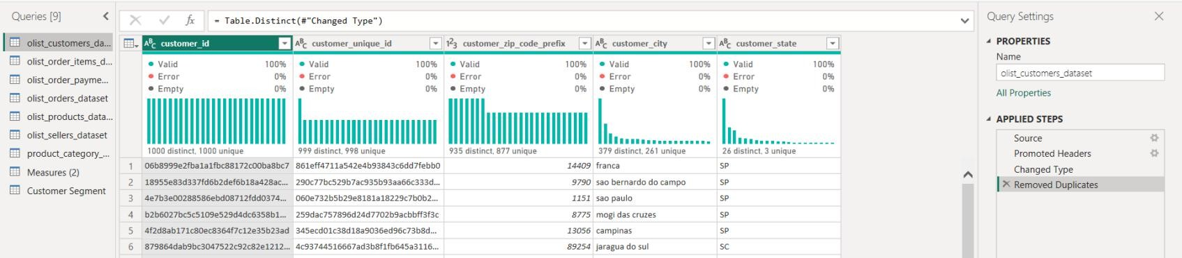
Objective 1: Data Preparation and Transformation
Imported all dataset tables into Power BI.
Removed duplicate and null records.
Corrected data types and standardized formats.
Performed column renaming and transformation using Power Query.

Slide 7
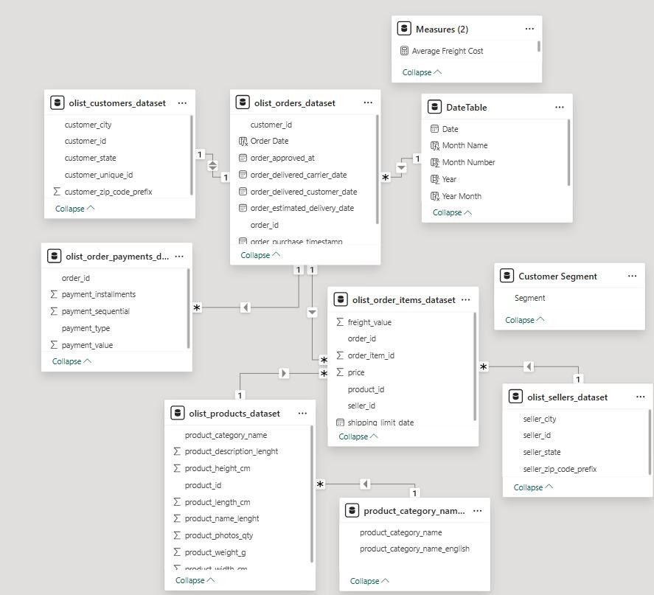
Objective 2 : Data Modeling and Relationship Building
Created relationships using Customer ID, Order ID, Product ID and Seller ID.
Implemented a Star Schema model.
Validated relationship integrity for accurate reporting.
Developed calculated columns and measures for analysis.

Slide 8
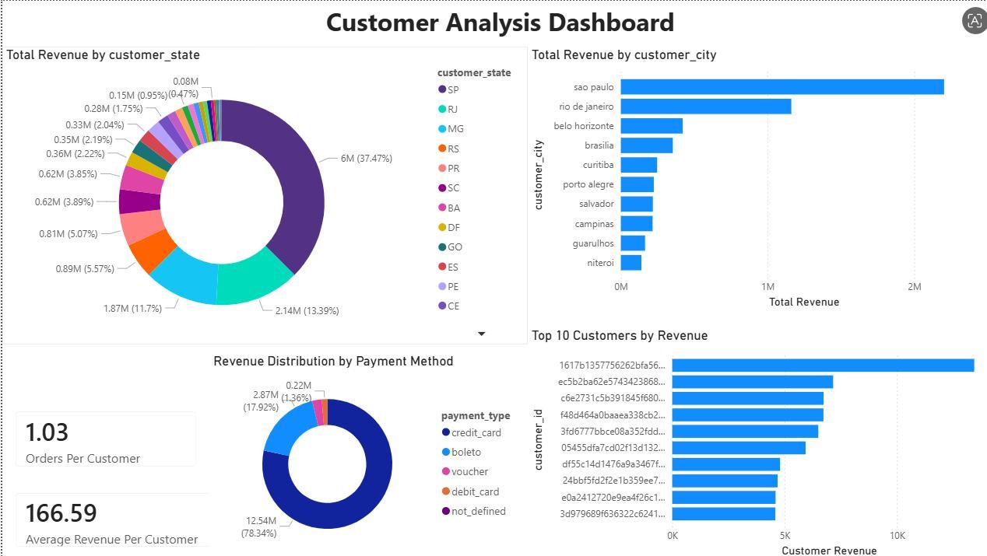
Objective 3 : Customer Purchase Behavior Analysis
Identified high-value customers.
Analyzed customer contribution to revenue.
Studied customer geographic distribution.
Examined preferred payment methods.
Evaluated repeat purchase behavior

Slide 9
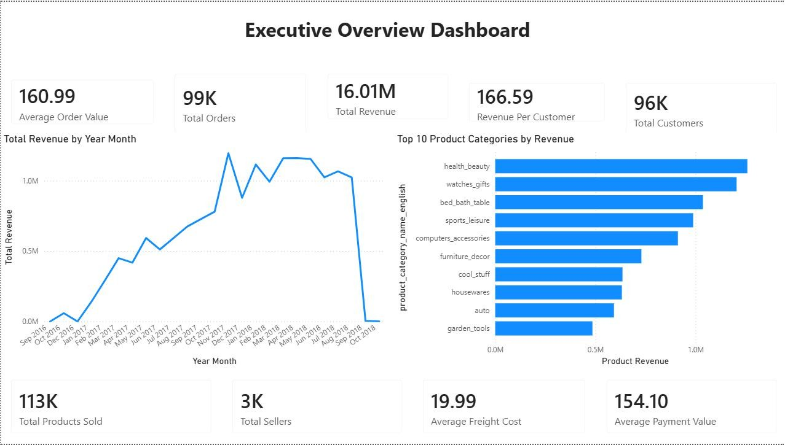
Objective 4 : KPI Development and Business Insight Generation

Slide 10
KPIs Developed:
Total Revenue
Total Orders
Total Customers
Average Order Value
Revenue Per Customer
Product Revenue
AI Insights:
Key Influencers identified factors affecting revenue.
Decomposition Tree enabled root-cause analysis.

Slide 11
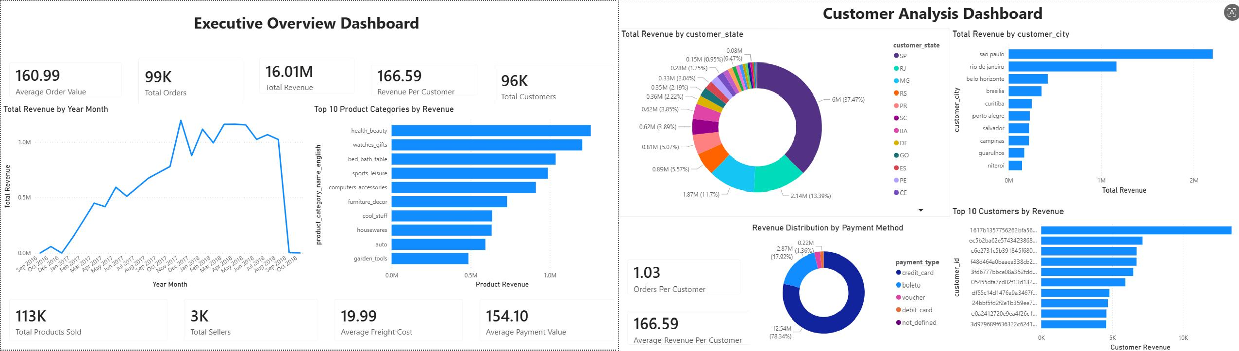
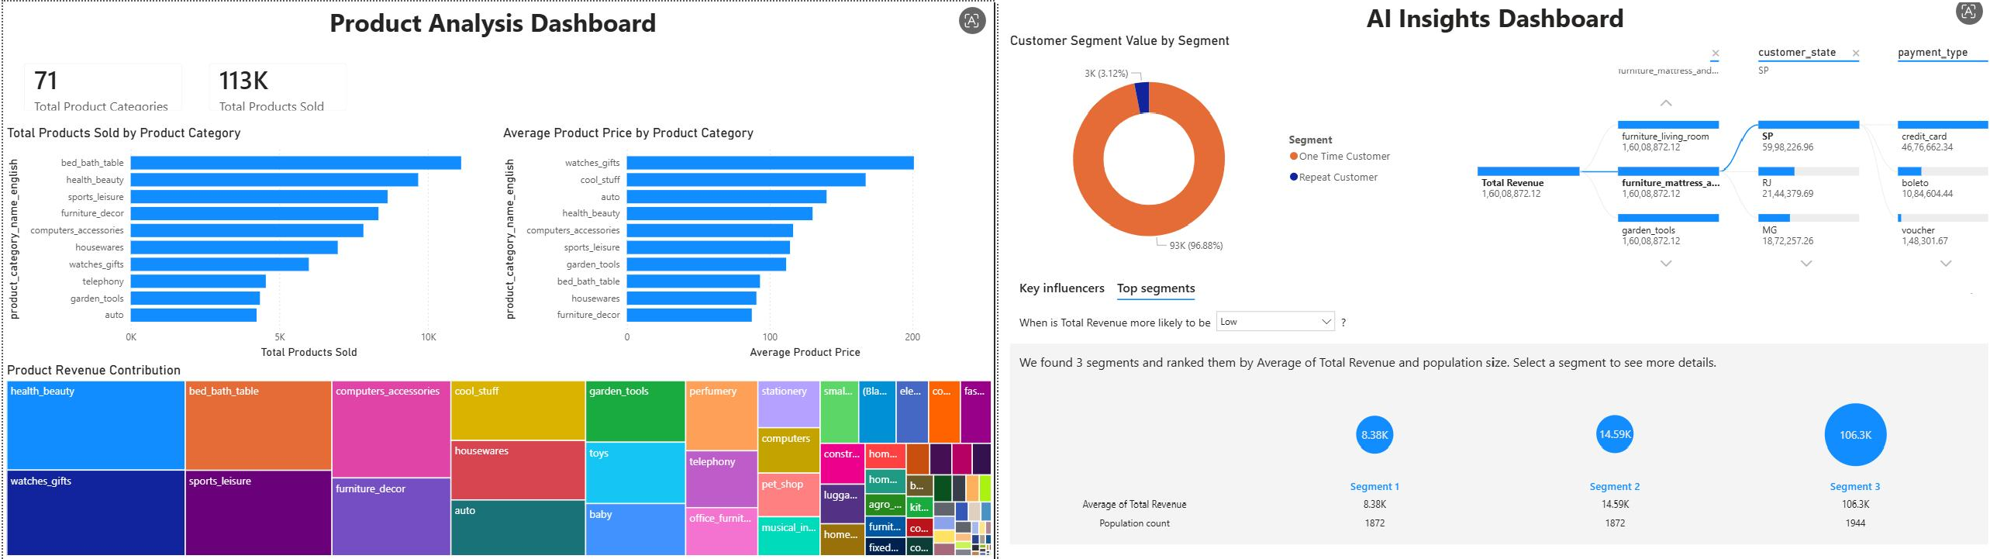
Objective 5 : Interactive Dashboard Development and Storytelling

Slide 12
GenAI Usage
Understanding dataset structure
Generating project documentation
Creating problem statements
Improving dashboard storytelling
Preparing presentation content
Generating insights and explanations
Assisting in report writing

Slide 13
Challenges Faced
Missing data in records
Duplicate entries
Combining multiple datasets
Maintaining data consistency
Understanding buying patterns
Creating meaningful visualizations
Identifying revenue factors

Slide 14
Conclusion
The project successfully analyzed customer purchase behavior.
Key Findings:
  Customer buying patterns identified
  Top-performing categories recognized
  Revenue trends analyzed
  Business opportunities discovered
The dashboard helps improve decision-making and customer satisfaction.

